Slide 1
MODULE : 51

Slide 2
BC²
BD
.
∠ACB = 90º and CD ⊥ AB. Prove that
=
AC²
AD
Sol:
ΔACB
∼
ΔADC
∼
ΔCDB
……..(i) [If a perpendicular is drawn from the vertex of the right angle of a right triangle to the hypotenuse then triangles on both sides of the perpendicular are similar to the whole triangle and to each other]
AC
AB
∴
=
AD
AC
∴
AC²
=
AB .
AD
… (ii)
A
ΔACB
∼
ΔCDB
AB
BC
∴
=
CB
DB
D
∴
BC²
=
AB .
DB
… (iii)
BC²
AB . BD
∴
=
From (ii) and (iii)
AC²
AB . AD
BC²
BD
i.e
=
C
B
AC²
AD

Slide 3
MODULE : 52

Slide 4
THEOREM OF PYTHAGORAS
In a right angled triangle
the square of the hypotenuse
is
In a right angled triangle, the square of the hypotenuse is
equal to the sum of the squares of the remaining two sides.
equal to
the sum of
the squares of the remaining two sides
In ΔABC,
∠ABC = 90º
A
(AC)²
(AB)²
(BC)²
=
+
[By Pythagoras theorem]
90°
B
C

Slide 5
THEOREM : Theorem of Pythagoras
In a right angled triangle, the square of the hypotenuse is
equal to the sum of the squares of the remaining two sides.
Given : In ΔABC, m∠ABC = 90º
No
A
In a right angled triangle, we have perpendicular from the vertex of right angle to the hypotenuse
AC²
Select the ratios
involving AB
Let us consider 2 triangles containing side BC
Select the ratios
involving BC
Let us consider 2 triangles containing side AB
Can we drop perpendiculars from A and C ?
To prove :
AC²
=
AB² + BC²
We already have it
D
We require squares of sides.
Construction : Draw seg BD ⊥ side AC such that, A-D-C
For similarity, we require minimum 2 triangles
AB² + BC²
Proof :
In ΔABC,
...(i)
Let us form it
For that, we would require the product
m∠ABC = 90º
[Given]
To form a right angled triangle we need to drop a perpendicular from the vertex to the opposite side
The existing triangle is what type of triangle ?
Right angled
triangle
So, we will drop a perpendicular from B to side AC
ΔABC ∼ ΔADB
[From (i)]
[Construction]
seg BD ⊥ hypotenuse AC
Similarity in right
angled triangles
B
And that can be obtained by using
similarity
Adding (ii) and (iii),
C
AB
Which theorem can we apply?
∴
AC
ΔABC ∼ ΔADB ∼ ΔBDC
[Similarity in right angled triangles]
∴
=
[c.s.s.t]
= (AD × AC)
AD
AB
AB² + BC²
+ (DC × AC)
That means, the triangle we require should be a right angled triangle
∴
AB²
= AD × AC
...(ii)
∴
AB² + BC²
= AC
(AD + DC)
ΔABC ∼ ΔBDC
∴
AB² + BC²
= AC
× AC
[From (i)]
BC
AC
∴
AB² + BC²
= AC²
∴
=
[c.s.s.t]
DC
BC
∴
AB² + BC²
AC²
=
∴
BC²
= DC × AC
...(iii)
Notes:
Maths

Slide 6
MODULE : 53

Slide 7
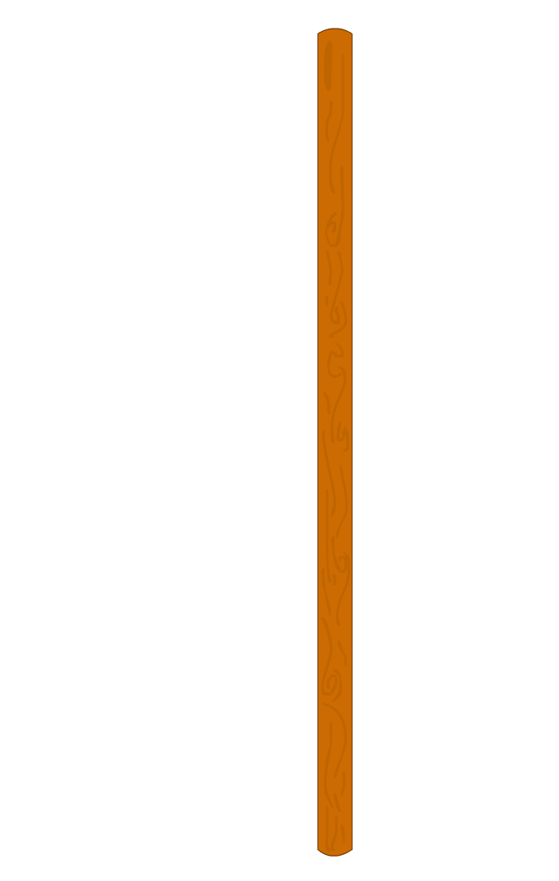
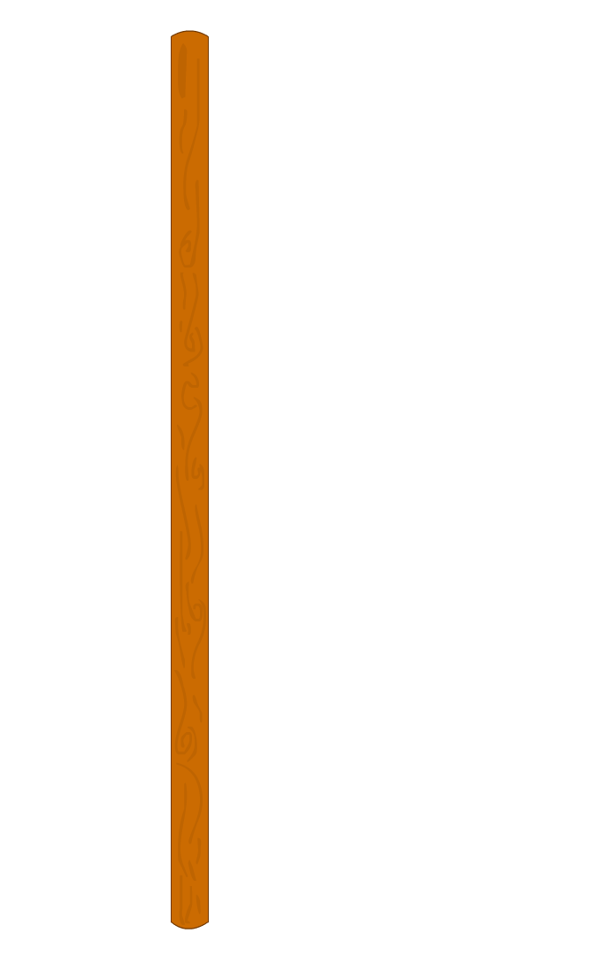
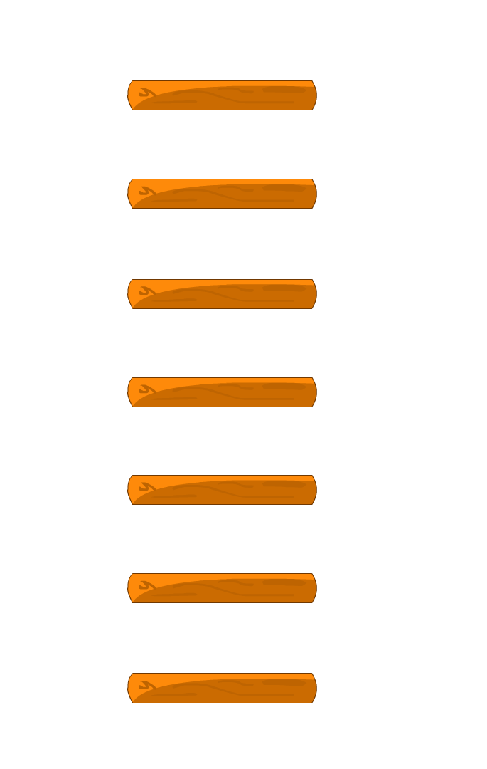
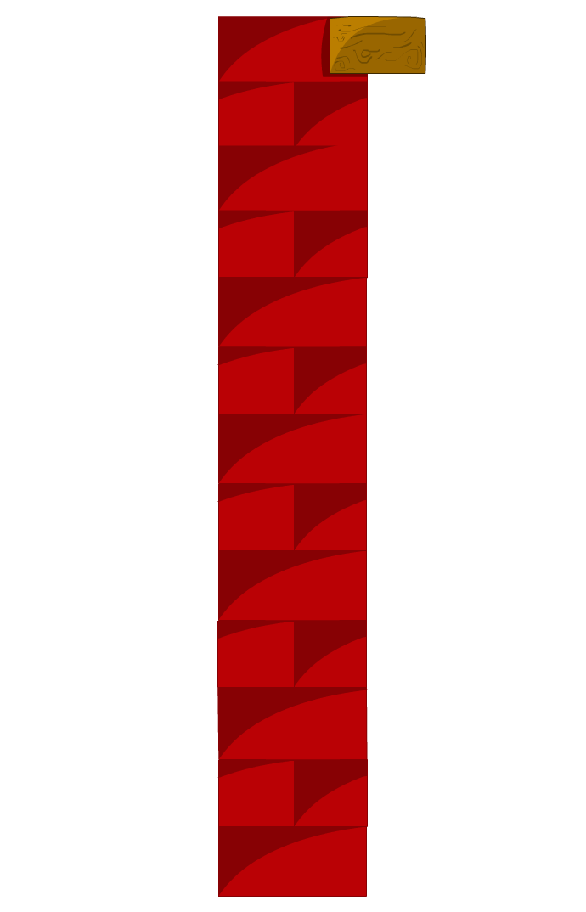
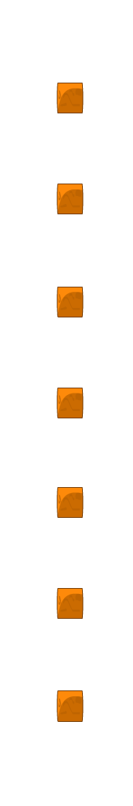
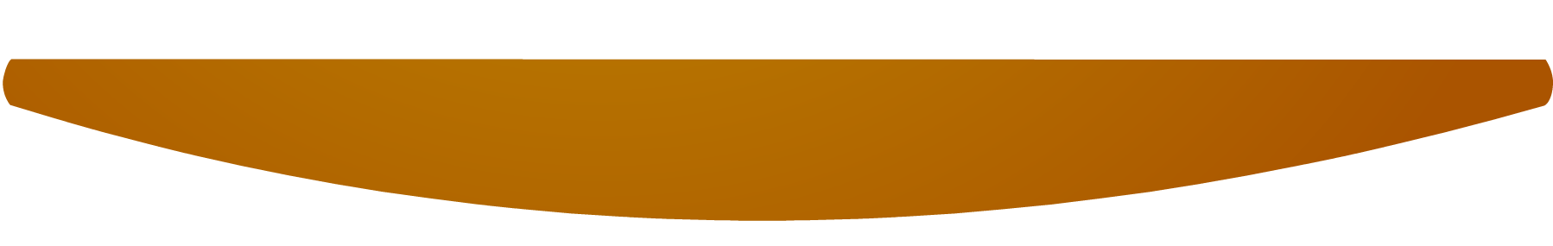
ladder 10m
reaches a window 8m above
Q. A ladder 10m long reaches a window 8m above the ground. Find the distance of the foot of the ladder from base of the wall.
Ex.6.5 (Q.9)
A
the ground.
distance of the foot of the
(window)
ladder from base of the wall.
Soln.
AB represents the height at which ladder reaches the
window above the ground.
window above the ground. AC represents length of
the ladder.
10
(Ladder)
AB
=
8m
,
AC
=
10m
,
In ΔABC,
∠ABC
=
90⁰
8
B
C
AC²
=
AB²
+
BC²
[By Pythagoras theorem]
(Ground)
10m
∴
( )²
=
( )²
+
BC²
10m
8μ
∴
100
=
64
+
BC²
∴
BC²
=
100
-
64
∴
BC²
=
36
∴
BC
=
6m
∴
Distance of the foot of the ladder from the base of the wall is 6m.
??

Slide 8
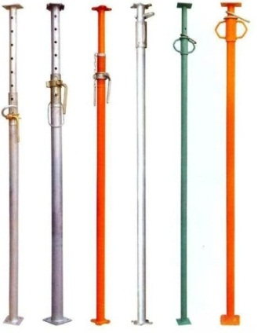
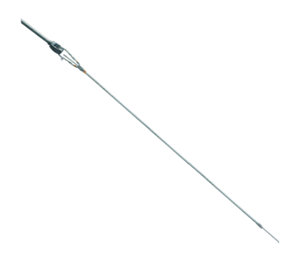




Ex.6.5 (Q.10)
Q. A guy wire is attached to a vertical pole of height 18m is
24m long & has a stake attached to the other end.
How far from the base of the pole should the stake be driven
so that the wire be will be taut?
A
Sol.
AB represents the length of vertical pole.
A
AC represents the length of wire
BC is the distance of stake from the base of the pole.
24 m
18 m
24 m
18 m
In ΔABC,
∠ABC
=
90°
AC²
=
AB²
+
BC²
[by Pythagoras theorem]
B
B
C
?
C
∴
24²
=
18²
+
BC²
∴
576
=
324
+
BC²
∴
BC²
=
576
–
324
=
252
∴
BC
=
$$\sqrt{\text{252}}$$
=
$$\sqrt{\text{36 }×\text{ 7}}$$
∴
BC
=
$$\sqrt{\text{7}}$$
6
Stake should be at a distance of 6 $\sqrt{\text{7}}$m from the base of the pole.

Slide 9
MODULE : 54

Slide 10
Ex.6.5 (Q.11)
Q. An aeroplane leaves an airport and flies due north at the speed of 1000km per hour. At the same time, another aeroplane leaves the same airport and flies due west at a speed of 1200 km per hour. How far apart will the two planes be after 1
1
2
hours.
1
2
3
2
Soln.
AB represents the distance covered by 1st areoplane.
1 hours =
hours.
AC represents the distance covered by 2nd areoplane.
Distance =
speed × time
B
500
3
AB
= 1000
×
= 1500 km
2
1000
km/hr
1500 km
Distance = speed × time
600
3
A
AC
= 1200
×
= 1800 km
C
1800 km
2
1200 km/hr

Slide 11
Ex.6.5 (Q.11)
Q. An aeroplane leaves an airport and flies due north at the speed of 1000km per hour. At the same time, another aeroplane leaves the same airport and flies due west at a speed of 1200 km per hour. How far apart will the two planes be after 1
Soln.
In ΔBAC,
∠BAC =
90⁰
(BC)² =
(AB)²
+ (AC)²
... [by Pythagoras theorem]
∴
(BC)² =
(1500)²
+
(1800)²
B
∴
(BC)² =
2250000
+ 3240000
∴
(BC)² =
5490000
1500 km
∴
BC =
√
5490000
=
√
9
× 61
× 100
× 100
BC =
300
√
61 km
C
A
∴
1800 km
∴ Distance between the two aeroplanes = 300
√
61 km

Slide 12
MODULE : 55

Slide 13
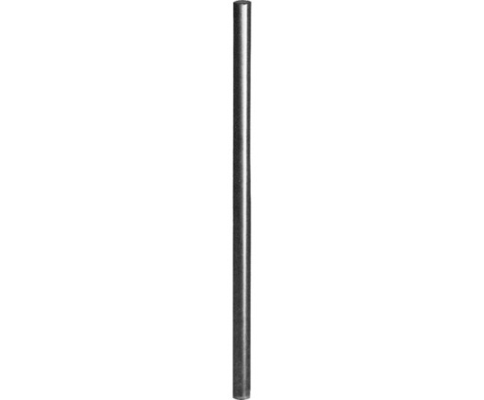


Ex.6.5 (Q.12)
Q. Two poles of heights 6m and 11m stand on a plane ground.
If the distance between the feet of the poles is 12m,
find the distance between their tops.
Sol.
AB and DC represent heights of two poles.
BC and AD represents the distance between their feet and tops respectively.
A
?
D
11 m
6 m
C
12 m
B

Slide 14
Ex.6.5 (Q.12)
Q. Two poles of heights 6m and 11m stand on a plane ground.
If the distance between the feet of the poles is 12m,
find the distance between their tops.
A
?
5 m
D
12 m
Sol.
AB and DC represent heights of two poles.
M
BC and AD represents the distance between
their feet and tops respectively.
11 m
6 m
6 m
Draw DM ⊥ AB
C
12 m
B
MBCD is a Rectangle
DM
=
BC
=
12m
DC
=
MB
=
6m
AM
=
AB
–
MB
∴
AM
=
11
–
6
∴
AM
=
5m

Slide 15
Ex.6.5 (Q.12)
Q. Two poles of heights 6m and 11m stand on a plane ground.
If the distance between the feet of the poles is 12m,
find the distance between their tops.
A
?
5 m
D
12 m
M
Sol.
In ΔAMD,
∠AMD
=
90°
11 m
AD²
=
AM²
+
DM²
[by Pythagoras theorem]
6 m
6 m
∴
AD²
=
5²
+
12²
C
12 m
B
∴
AD²
=
25
+
144
∴
AD²
=
169
∴
AD
=
13m
Distance between the tops is 13 m.

Slide 16
Thank You

